Slide 1
Lawyer
Jessica Old
5/1/2013
3rd hour
Career/Technology Foundations

Slide 2
Introduction
“It is in the spirit and not the form of law that keeps justice alive,” –Earl Warren.
I believe this quote means that unless you are passionate about wanting justice, you cannot fully get it by just knowing law.
I became interested in becoming a lawyer when I joined a class in 9th grade called Mock Trial. Mock Trial is a group where teams go face to face with another school in a actual courtroom and portray a case. Once I did this I realized I was really interested in law and that I was good at it too.
In order to get a better understanding of my career as a lawyer, I will be researching:
Nature of Work
Working Conditions
Training, Qualifications, Advancements
Job Outlook/Employment
Earnings
A Backup Career

Slide 3
Nature of Work
Advise and represent clients in courts, before government agencies, or in private legal matters
Communicate with their clients and others
Conduct research and analysis of legal problems
Interpret laws, rulings, and regulations for individuals and businesses
Present facts in writing or verbally to their clients or others and argue on their behalf
Prepare and file legal documents, such as lawsuits, appeals, wills, contracts, and deeds

Slide 4
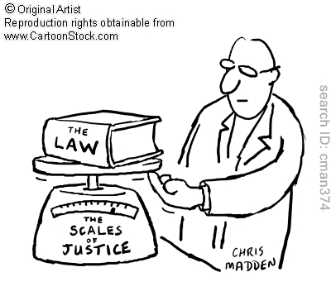
Working Conditions
Mental
Memorizing rules and thinking on the spot.
Indoor
Working in office and courtroom.
Hours
Varies between 10-15
Environment
Fast pace, challenging, and quiet

Slide 5
Training, Qualification, Advancement
Degree
At least a Bachelor
Schools
U of M, MSU, Wayne State, Alabama
Classes
Mock Trial, Practical Law

Slide 6
Job Outlook/Employment
Employment Rate
As fast as Average
Rising
Growing 10% from 2010-2020
Competitive
More students graduating then jobs available
Place of employment
Washington D.C, Michigan (somewhere), California

Slide 7
Earnings
Average Earnings
$112,760
Goals:
House on the lake $1,300- $2,400 per acre -
Own a German Shepherd $500 +
Ford F-150 $23,000-$50,000 (2013 model) -
Red Wings Glass tickets $180 +

Slide 8
Related Occupation - Doctor
Responsibilities
Diagnose and treat injuries
Work Conditions
Standing long periods, in a hospital
Training
4 years undergrad, 4 years medical, 3-8 years of intern and residency
Outlook
Faster then average (grow 24% by 2020), competitive (technology)
Earnings
$343,958 average yearly, $80 average hourly
Why I chose it
choice since childhood, can help people, sounds like fun

Slide 9
Summary
The one thing I look forward to the most with being a lawyer is that I can learn to get my nerves under control. I wont get nervous all the time or get scared that I’ll mess up. I don’t look forward to the long nights in an office, but I learned that if its something I like to do, time would go by quickly. Being a lawyer it would make me feel important. It would make me feel like I’m doing something that matters. Plus, lawyers get to sound smart when they talk and I think that is awesome!

Slide 10
Citations
http://quotegarden.com/justice.html
http://acreage.gladwinrealestateagent.com/acreage-pricing
http://www.hoobly.com/12014/1781/0/
http://www.stubhub.com/detroit-red-wings-playoff-tickets/detroit-red-wings-detroit-joe-louis-arena-4-5-2013-4261572/
http://usnews.rankingsandreviews.com/cars-trucks/Ford_F-150/prices/
http://www.bls.gov/ooh/legal/lawyers.htm
http://www.bls.gov/ooh/Healthcare/Physicians-and-surgeons.htm

